Slide 1
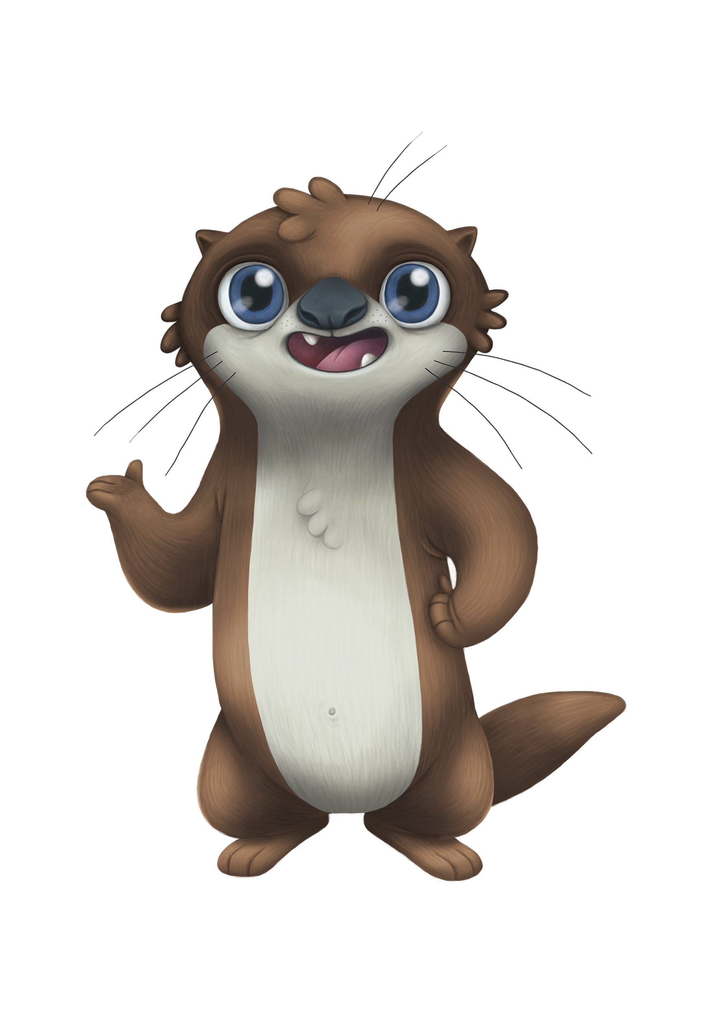
Water4Otter
Check for Understanding
Lesson 2

Slide 2
Question #1:
What is the area around Lavon Lake (where Bob the bobcat lives) called?

Slide 3
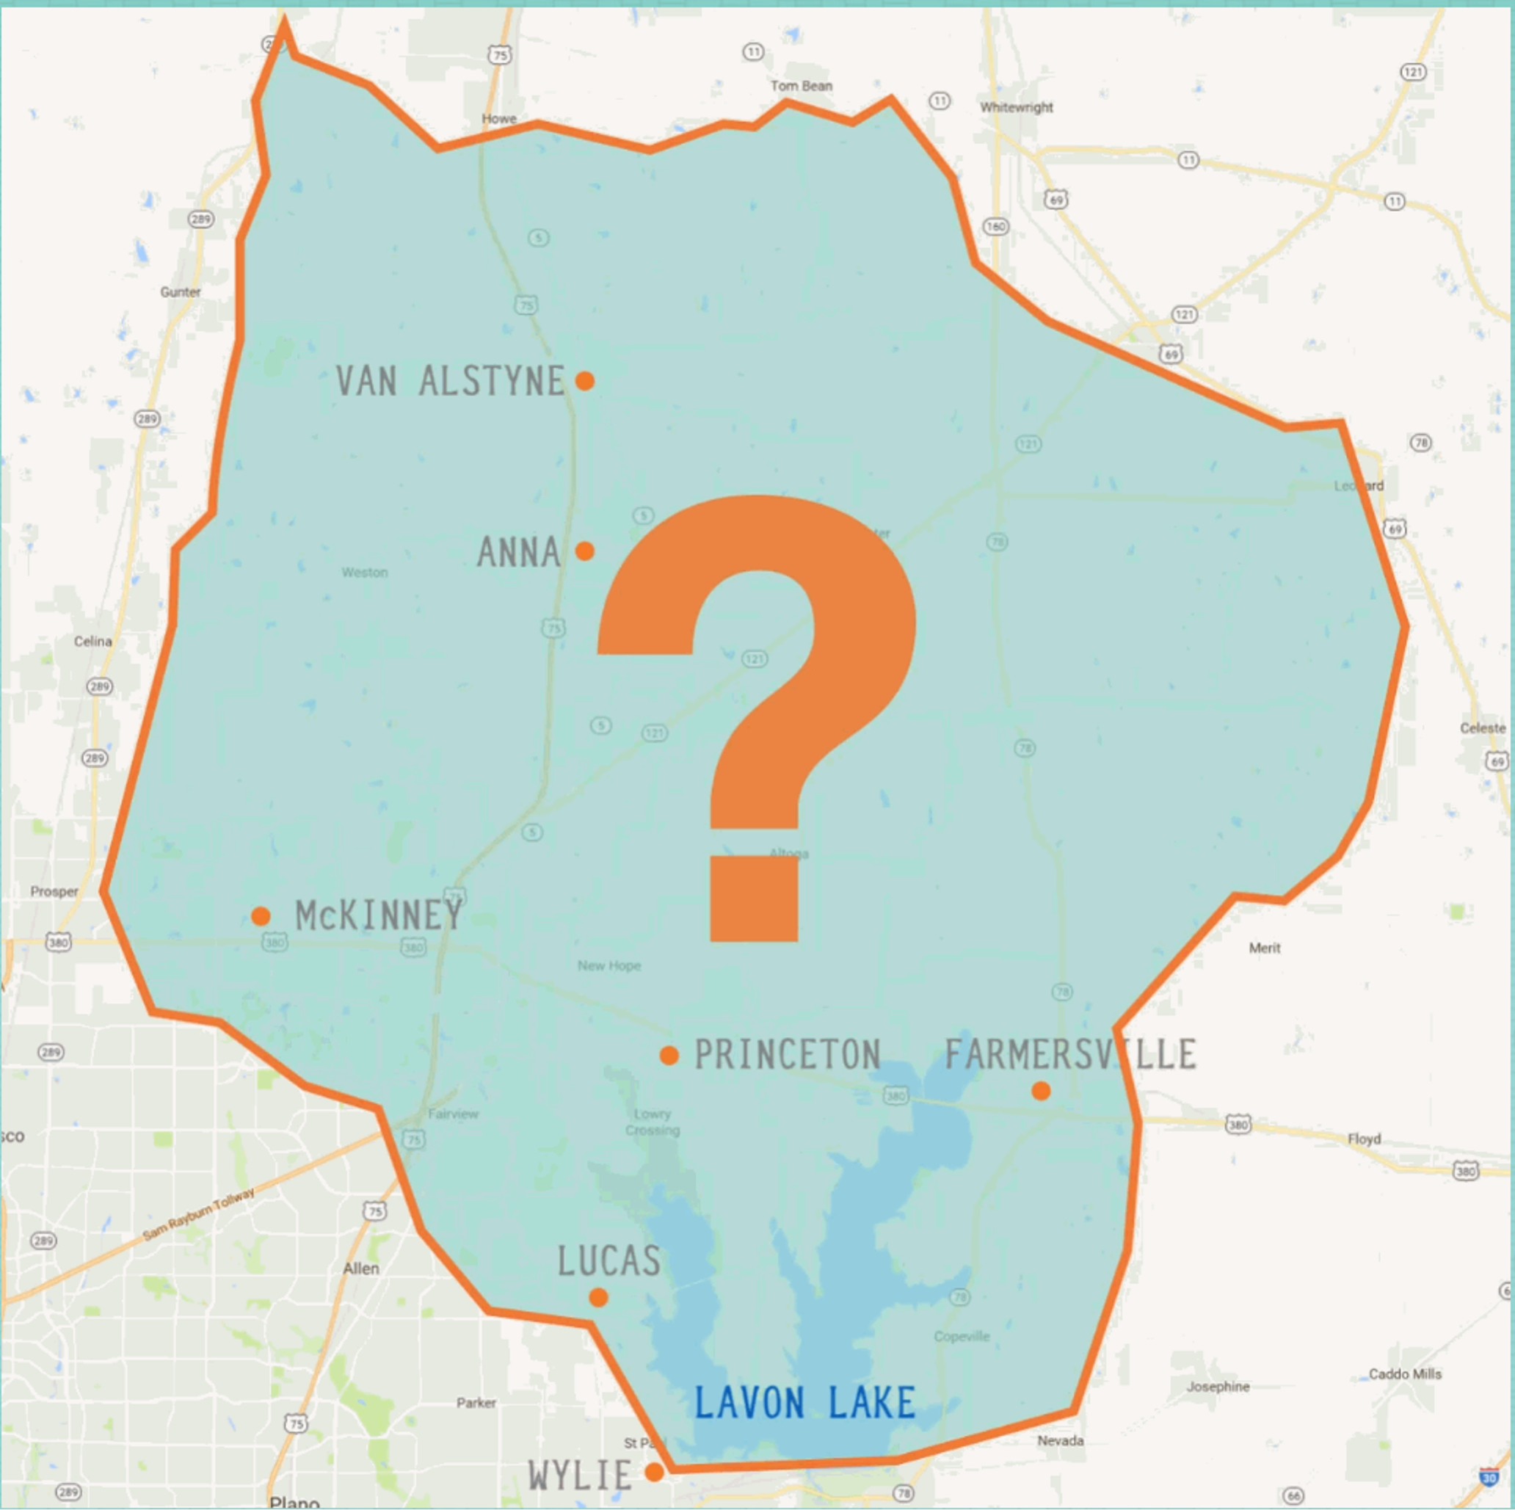
Question #1:
What is the area around Lavon Lake (where Bob the bobcat lives) called?
A pool
A watershed
The ocean
A river

Slide 4
Question #1:
What is the area around Lavon Lake (where Bob the bobcat lives) called?
A pool
A watershed
The ocean
A river

Slide 5
Question #2:
Who lives in a watershed?

Slide 6
Question #2:
Who lives in a watershed?
Humans (you and me)
Bob the bobcat
Family pets
All of the above

Slide 7
Question #2:
Who lives in a watershed?
Humans (you and me)
Bob the bobcat
Family pets
All of the above

Slide 8
Question #3:
What happens if we throw trash on the ground?

Slide 9
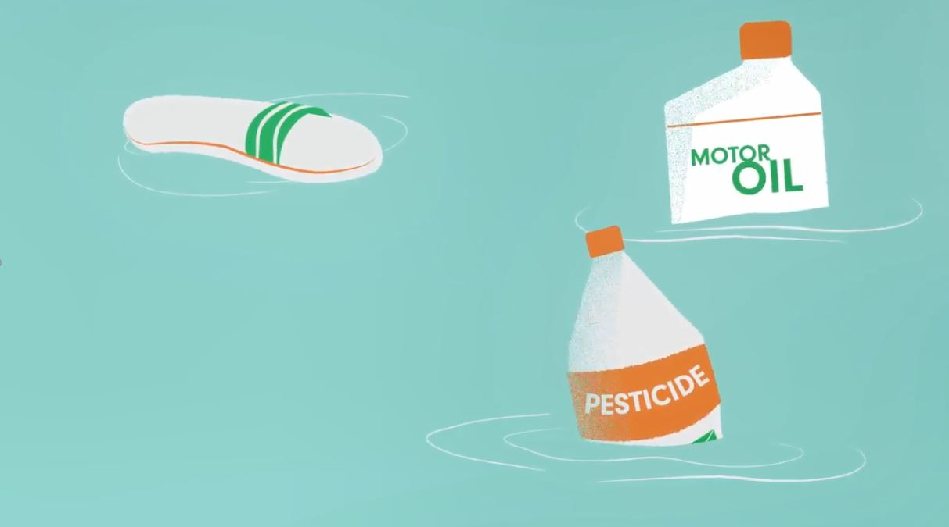
Question #3:
What happens if we throw trash on the ground?
Nothing
It will end up in Lavon Lake
It just disappears
It expands into more trash

Slide 10
Question #3:
What happens if we throw trash on the ground?
Nothing
It will end up in Lavon Lake
It just disappears
It expands into more trash

Slide 11
Great job!

